Slide 1
Md Amjad Hossain
Slides are taken from Suk Jin Lee

Slide 2

Heaps
A heap is a binary tree with properties:
It is complete
Each level of tree completely filled
Except possibly bottom level (nodes in left most positions)
It satisfies heap-order property (two kinds of heaps)
Max-heap: for all node i, excluding the root
A[Parent(i)] ≥ A[i]
Min-heap: for all node i, excluding the root
A[Parent(i)] ≤ A[i]

Slide 3
Heaps
Which of the following are heaps?
A
9
B
9
C
9
8
4
8
4
6
4
6
2
3
6
2
3
8
2
3
Yes, it is a heap…!
No, it is not, b/c it is not complete…!
Complete! But, it is not, b/c heap-order condition is not satisfied…!

Slide 4
Heaps
A heap can be seen as a complete binary tree:
16
14
10
8
7
9
3
2 4 1
What makes a binary tree complete?
Is the example above complete?

Slide 5
Heaps
A heap can be seen as a complete binary tree:
16
14
10
8
7
9
3
2
4
1
The book calls them “nearly complete” binary trees; can think of unfilled slots as null pointers

Slide 6
Heaps
In practice, heaps are usually implemented as arrays:
1
2
14
16
3
10
1 2 3 4
5
6
7
8
9 10
A =
16 | 14 | 10 | 8 | 7 | 9 | 3 | 2 | 4 | 1
4
8
5
7
6
9
7
3
8
2
9
4
10
1

Slide 7
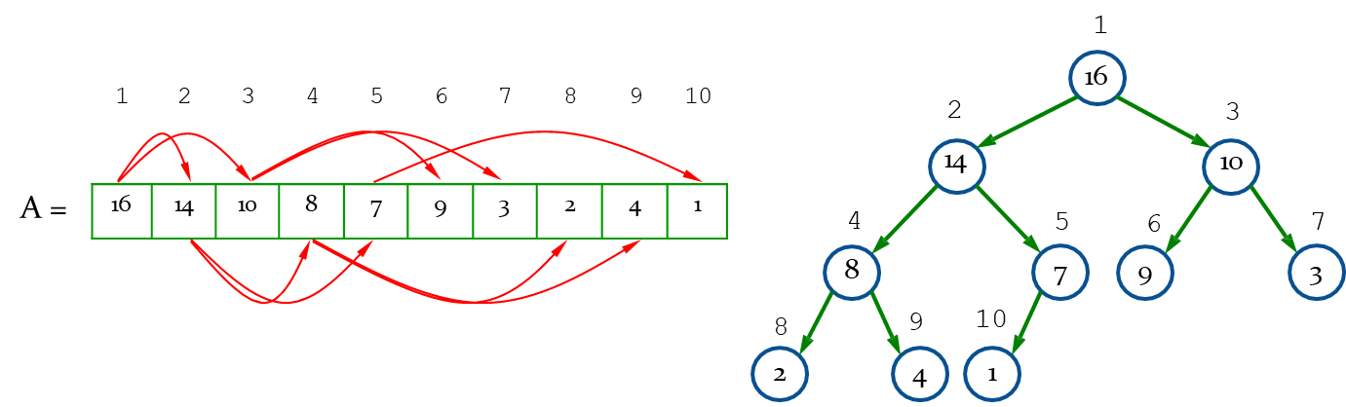
Heaps
To represent a complete binary tree as an array:
The root node is A[1]
Node i is A[i]
The parent of node i is A[i/2] (note: integer divide)
The left child of node i is A[2i]
The right child of node i is A[2i + 1]

Slide 8
Referencing Heap Elements
So, we can get
PARENT(i)
return ⎣i/2⎦
LEFT(i)
return 2×i
RIGHT(i)
return 2×i + 1

Slide 9
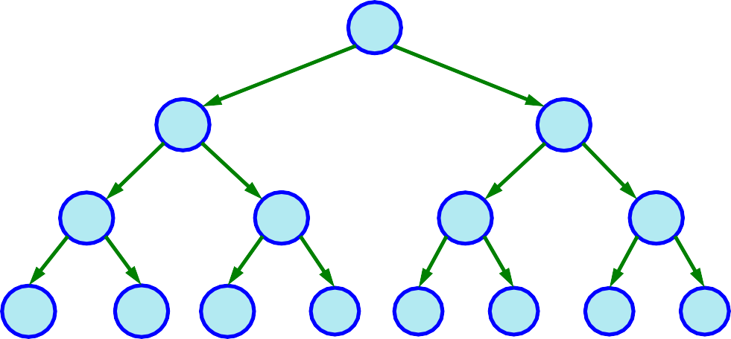
Quiz – 1
What are the minimum and maximum numbers of elements in a heap of height h?

Slide 10
Quiz – 1
What are the minimum and maximum numbers of elements in a heap of height h?
h = 0
h = 1
h = 2
h = 3
2^{h+1} – 1 elements if complete

Slide 11
Quiz – 1
What are the minimum and maximum numbers of elements in a heap of height h?
2^{h+1} – 1 elements
h = 0
h = 1
h = 2
h = 3
At least 2^{h} – 1 + 1 = 2^{h} elements

Slide 12
Quiz – 1
What are the minimum and maximum numbers of elements in a heap of height h?
Since a heap is an almost-complete binary tree, it has at most 2^{h+1} – 1 elements (if it is complete) -Maximum
At least 2^{h} – 1 + 1 = 2^{h} elements - Minimum
If the lowest level has just 1 element and the other levels are complete
Therefore
2^{h} ≤ n ≤ 2^{h+1} – 1

Slide 13
Quiz – 2
Show that an n-element heap has height ⎣lg n⎦ / O(logn)

Slide 14
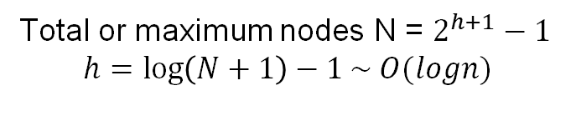
Quiz – 2
Show that an n-element heap has height ⎣lg n⎦ / O(logn)
h = 0
h = 1
h = 2
h = 3
Total or maximum nodes N = $2^{h+1}−1$
$$h=\log\left(N+1\right)−1 \sim O(logn)$$

Slide 15
The Heap Property
Heaps also satisfy the heap property: A[PARENT(i)] ≥ A[i] for all nodes i > 1
In other words, the value of a node is at most the value of its parent
Where is the largest element in a heap stored?
Definitions:
The height of a node in the tree = the number of edges on the longest downward path to a leaf.
The height of a tree = the height of its root

Slide 16
Why Heap Height is Important?
basic heap operations take at most time proportional to the height of the heap. ~ O(logn)

Slide 17
Maintaining the heap property
Max-Heapify
Used to maintain the max-heap property
Before Max-Heapify, A[i] may be smaller than its children
Assume left and right subtrees of i are max-heaps
After Max-Heapify, subtree rooted at i is a max-heap

Slide 18
Maintaining the heap property
Max-Heapify
MAX-HEAPIFY(A, i)
l = LEFT(i)
r = RIGHT(i)
if l ≤ A.heap-size and A[l] > A[i] largest = l
else largest = i
if r ≤ A.heap-size and A[r] > A[largest] largest = r
if largest ≠ i
exchange A[i] with A[largest]
MAX-HEAPIFY(A, largest)

Slide 19
Max-Heapify() Example
MAX-HEAPIFY(A, 2)
1
16
2
4
3
10
4
14
5
7
6
9
7
3
8
2
9
8
10
1
1
2
3
4
5
6
7
8
9
10
A =
16
4 | 10 | 14 | 7 | 9 | 3 | 2 | 8 | 1

Slide 20
Max-Heapify() Example
MAX-HEAPIFY(A, 2)
1
16
2
4
3
10
4
14
5
7
6
9
7
3
8
2
9
8
10
1
1
2
3
4
5
6
7
8
9
10
A =
16
4
10
14 | 7 | 9 | 3 | 2 | 8 | 1

Slide 21
Max-Heapify() Example
MAX-HEAPIFY(A, 2)
1
16
2
14
3
10
4
4
5
7
6
9
7
3
8
2
9
8
10
1
1
2
3
4
5
6
7
8
9
10
A =
16 | 14 | 10 | 4 | 7 | 9 | 3 | 2 | 8 | 1

Slide 22
Max-Heapify() Example
MAX-HEAPIFY(A, 4)
1
16
2
14
3
10
4
4
5
7
6
9
7
3
8
2
9
8
10
1
1
2
3
4
5
6
7
8
9
10
A =
16
14
10
4
7 | 9 | 3 | 2 | 8 | 1

Slide 23
Max-Heapify() Example
MAX-HEAPIFY(A, 4)
1
16
2
14
3
10
4
4
5
7
6
9
7
3
8
2
9
8
10
1
1
2
3
4
5
6
7
8
9
10
A =
16 14 10
4
7
9
3
2
8
1

Slide 24
Max-Heapify() Example
MAX-HEAPIFY(A, 4)
1
16
2
14
3
10
4
8
5
7
6
9
7
3
8
2
9
4
10
1
1
2
3
4
5
6
7
8
9
10
A =
16 | 14 | 10 | 8 | 7 | 9 | 3 | 2 | 4 | 1

Slide 25
Max-Heapify() Example
MAX-HEAPIFY(A, 9)
1
16
2
14
3
10
4
8
5
7
6
9
7
3
8
2
9
4
10
1
1
2
3
4
5
6
7
8
9
10
A =
16 | 14 | 10 | 8 | 7 | 9 | 3 | 2
4
1

Slide 26
Max-Heapify() Example
MAX-HEAPIFY(A, 9)
1
16
2
14
3
10
4
8
5
7
6
9
7
3
8
2
9
4
10
1
1
2
3
4
5
6
7
8
9
10
A =
16 | 14 | 10 | 8 | 7 | 9 | 3 | 2 | 4 | 1

Slide 27
Analyzing Heapify(): Informal
Aside from the recursive call, what is the running time of Heapify()?
How many times can Heapify() recursively call itself?
What is the worst-case running time of Heapify() on a heap of size n?

Slide 28
Analyzing Heapify(): Formal
Fixing up relationships between i, l, and r takes Θ(1) time
If the heap at i has n elements, how many elements can the subtrees at l or r have?
Answer: 2n/3 (worst case: bottom level of tree 1/2 full)
So time taken by Heapify() is given by
T(n) ≤ T(2n/3) + Θ(1)
To solve the equation, check the page 102-103 of the textbook.
Also: https://www.programiz.com/dsa/master-theorem

Slide 29
Analyzing Heapify(): Formal
So we have
T(n) ≤ T(2n/3) + Θ(1)
a = 1, b = 3/2, f(n) = Θ(1)
f (n) = Θ(n^{logb a} )= Θ(n^{log3 / 2 1} ) = Θ(n⁰ ) = Θ(1)
By case 2 of the Master Theorem
T (n) = Θ(n^{logb a} lg n)= Θ(lg n)
Thus, Heapify() takes linear time
To solve the equation, check the page 102-103 of the textbook.
Also: https://www.programiz.com/dsa/master-theorem

Slide 30
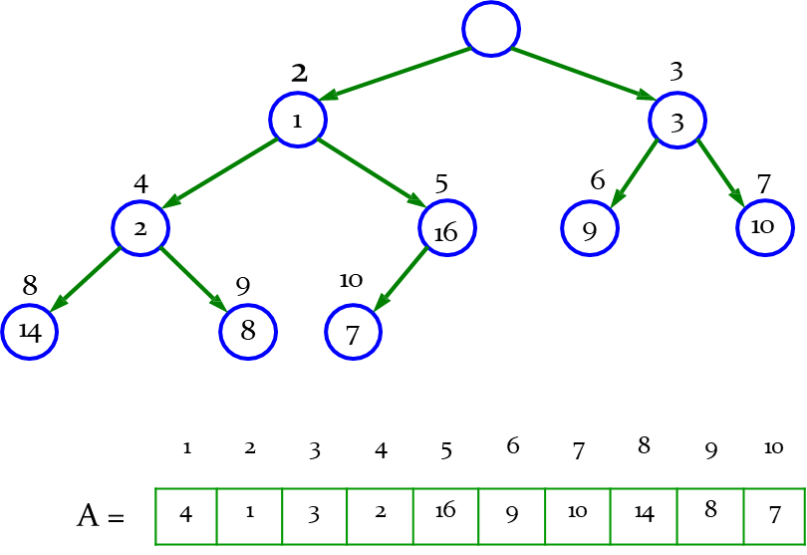
Building a heap
Use the procedure Max-Heapify in a bottom-up manner to convert an array A[1..n], where n = A.length, into a max-heap.
Build-Max-Heap(A)
A.heap-size = A.length
for i = ⎣A.length / 2⎦ downto 1
Max-heapify(A, i)
Simple upper bound
O(n)
O(lg n)
Each call to Max-Heapify costs O(lg n) time, and Build- Max-Heap make O(n) such call.
Thus, the running time is O(n lg n)

Slide 31
Building a heap
Tight bound
n-element heap has height ⎣lg n⎦
At most ⎡n/2^{h+1}⎤ nodes of any height
Time required by Max-Heapify when called on a node of any height h is O(h)
Total cost
⎣lg n ⎦⎡ ⎣lg n ⎦ _{h ⎞}
⎤
⎢ ⎥
⎛
n
⎛ h ⎞
∑
Ο(h) = Ο⎜ n
∑
∞
÷ = Ο(n)
÷ = Ο
⎜ n
∑
Details Here
2
h+1
2
h
2
h
h=0
⎝ ⎠
⎝ h=0 ⎠
h=0
We can build a max-heap from an unordered array in linear time

Slide 32
Building a heap Example
Work through example: 10-element input array A
1
4
2
1
3
3
4
2
5
6
9
7
10
16
8
14
9
8
10
7
1
2
3
4
5
6
7
8
9
10
A =
4 | 1 | 3 | 2 | 16 | 9 | 10 | 14 | 8 | 7

Slide 33
Building a heap Example
i = 5; before the call MAX-HEAFIFY(A, i) ; start the last parent = index of last element/2 = 10/2 = 5
1
4
2
1
3
3
4
2
5
6
9
7
10
16
8
14
9
8
10
7
1
2
3
4
5
6
7
8
9
10
A =
4 | 1 | 3 | 2
16
9 | 10 | 14 | 8 | 7

Slide 34
Building a heap Example
i = 4
1
4
2
1
3
3
4
2
5
6
9
7
10
16
8
14
9
8
10
7
1
2
3
4
5
6
7
8
9
10
A =
4
1
3
2
16 | 9 | 10 | 14 | 8 | 7

Slide 35
Building a heap Example
i = 4; call MAX-HEAFIFY(A, i)
1
4
2
1
3
3
4
2
5
6
9
7
10
16
8
14
9
8
10
7
1
2
3
4
5
6
7
8
9
10
A =
4
1
3
2
16
9
10
14
8
7

Slide 36
Building a heap Example
i = 4; after the call MAX-HEAFIFY(A, i)
1
4
2
1
3
3
4
14
5
6
9
7
10
16
8
2
9
8
10
7
1
2
3
4
5
6
7
8
9
10
A =
4 | 1 | 3 | 14 | 16 | 9 | 10 | 2 | 8 | 7

Slide 37
Building a heap Example
i = 3
1
4
2
1
3
3
4
14
5
6
9
7
10
16
8
2
9
8
10
7
1
2
3
4
5
6
7
8
9
10
A =
4
1
3
14 | 16 | 9 | 10 | 2 | 8 | 7

Slide 38
Building a heap Example
i = 3; call MAX-HEAFIFY(A, i)
1
4
2
1
3
3
4
14
5
6
9
7
10
16
8
2
9
8
10
7
1
2
3
4
5
6
7
8
9
10
A =
4
1
3
14
16
9
10
2 | 8 | 7

Slide 39
Building a heap Example
i = 3; after the call MAX-HEAFIFY(A, i)
1
4
2
1
3
10
4
14
5
6
9
7
3
16
8
2
9
8
10
7
1
2
3
4
5
6
7
8
9
10
A =
4 | 1 | 10 | 14 | 16 | 9 | 3 | 2 | 8 | 7

Slide 40
Building a heap Example
i = 2
1
4
2
1
3
10
4
14
5
6
9
7
3
16
8
2
9
8
10
7
1
2
3
4
5
6
7
8
9
10
A =
4
1 | 10 | 14 | 16 | 9 | 3 | 2 | 8 | 7

Slide 41
Building a heap Example
i = 2; call MAX-HEAFIFY(A, i)
1
4
2
1
3
10
4
14
5
6
9
7
3
16
8
2
9
8
10
7
1
2
3
4
5
6
7
8
9
10
A =
4
1 | 10 | 14 | 16 | 9 | 3 | 2 | 8 | 7

Slide 42
Building a heap Example
i = 2
1
4
2
16
3
10
4
14
5
1
6
9
7
3
8
2
9
8
10
7
1
2
3
4
5
6
7
8
9
10
A =
4 | 16 | 10 | 14 | 1 | 9 | 3 | 2 | 8 | 7

Slide 43
Building a heap Example
i = 2; recursively call MAX-HEAFIFY(A, largest)
1
4
2
16
3
10
4
14
5
1
6
9
7
3
8
2
9
8
10
7
1
2
3
4
5
6
7
8
9
10
A =
4 | 16 | 10 | 14
1
9
3
2
8
7

Slide 44
Building a heap Example
i = 2
1
4
2
16
3
10
4
14
5
7
6
9
7
3
8
2
9
8
10
1
1
2
3
4
5
6
7
8
9
10
A =
4 | 16 | 10 | 14 | 7 | 9 | 3 | 2 | 8 | 1

Slide 45
Building a heap Example
i = 1
1
4
2
16
3
10
4
14
5
7
6
9
7
3
8
2
9
8
10
1
1
2
3
4
5
6
7
8
9
10
A =
4
16 | 10 | 14 | 7 | 9 | 3 | 2 | 8 | 1

Slide 46
Building a heap Example
i = 1; call MAX-HEAFIFY(A, i)
1
4
2
16
3
10
4
14
5
7
6
9
7
3
8
2
9
8
10
1
1
2
3
4
5
6
7
8
9
10
A =
4 | 16 | 10 | 14 | 7 | 9 | 3 | 2 | 8 | 1

Slide 47
Building a heap Example
i = 1
1
16
2
4
3
10
4
14
5
7
6
9
7
3
8
2
9
8
10
1
1
2
3
4
5
6
7
8
9
10
A =
16 | 4 | 10 | 14 | 7 | 9 | 3 | 2 | 8 | 1

Slide 48
Building a heap Example
i = 1; recursively call MAX-HEAFIFY(A, largest)
1
16
2
4
3
10
4
14
5
7
6
9
7
3
8
2
9
8
10
1
1
2
3
4
5
6
7
8
9
10
A =
16
4
10
14 | 7 | 9 | 3 | 2 | 8 | 1

Slide 49
Building a heap Example
i = 1
1
16
2
14
3
10
4
4
5
7
6
9
7
3
8
2
9
8
10
1
1
2
3
4
5
6
7
8
9
10
A =
16 | 14 | 10 | 4 | 7 | 9 | 3 | 2 | 8 | 1

Slide 50
Building a heap Example
i = 1; recursively call MAX-HEAFIFY(A, largest)
1
16
2
14
3
10
4
4
5
7
6
9
7
3
8
2
 | 9 | 10
 | 8 |  | 1
1 | 2 | 3 |  | 4 | 5 | 6 | 7 | 8 | 9 | 10
16 | 14 | 10 |  | 4 | 7 | 9 | 3 | 2 | 8 | 1
A =

Slide 51
Building a heap Example
The max-heap after BUILD-MAX-HEAP finishes
1
16
2
14
3
10
4
8
5
7
6
9
7
3
8
2
9
4
10
1
1
2
3
4
5
6
7
8
9
10
A =
16 | 14 | 10 | 8 | 7 | 9 | 3 | 2 | 4 | 1

Slide 52
Quiz – 3
Using the previous figure model, illustrate the operation of BUILD-MAX-HEAP on the array
A = ⟨5, 3, 17, 10, 84, 19, 6, 22, 9⟩

Slide 53
Quiz – 3
Using the previous figure model, illustrate the operation of BUILD-MAX-HEAP on the array
A = ⟨5, 3, 17, 10, 84, 19, 6, 22, 9⟩
1
5
2
3
3
17
4
10
5
84
6
19
7
6
8
22
9
9
1
2
3
4
5
6
7
8
9
A =
5 | 3 | 17 | 10 | 84 | 19 | 6 | 22 | 9

Slide 54
Heapsort algorithm
Heapsort algorithm
Build a max-heap on the input array A[1..n] (n = A.length)
Root A[1]: the maximum element of the array A
Put A[1] into its correct final position A[n]
Discard node from the heap: A.heap-size – 1
Restore the max-heap property
Repeats this process until A.heap-size = 2

Slide 55
Heapsort algorithm
HEAPSORT(A)
BUILD-MAX-HEAP(A)
for i = A.length downto 2
exchange A[1] with A[i]
A.heap-size = A.heap-size – 1
MAX-HEAPIFY(A, 1)
O(n)
n – 1
n – 1
n – 1
(n-1)* O(lg n)
Thus, the total time taken by HeapSort()
= O(n) + 2*(n-1) + (n – 1) O(lg n)
= O(n) + O(n lg n)
= O(n lg n)

Slide 56
Example
Operation of Heapsort
16
1
14
Exchange root with last
14
10
Decrement heap side
HEAPIFY
8
10
14
10
8
7
9
3
8
7
9
3
4
7
9
3
i
16
2
4
1
2
4
16
2
1

Slide 57
Example
Operation of Heapsort
10
9
8
9
8
3
4
7
1
3
4
7
1
2
i
14 16
i
2
10
14 16

Slide 58
Example
Operation of Heapsort
8
7
7
3
4
3
i
8
i
4
2
1
9
1
2
9
10
14 16
10
14 16

Slide 59
Example
Operation of Heapsort
4
3
2
3
2
1
i
i
1
7
8
9
4
7
8
9
10
14 16
10
14 16

Slide 60
Example
Operation of Heapsort
2
1
i
i
1
3
2
3
4
7
8
9
4
7
8
9
10
14 16
10
14 16
A
1 | 2 | 3 | 4 | 7 | 8 | 9 | 10 | 14 | 16

Slide 61
Heap for Priority Queue
Create a heap based on the priority keys. Highest priority key will be at the root(min/max).
Placing a new item in the heap takes the cost of Heapify O(logn), in regular sorted array it could be O(n)
Taking the root-high priority item from the root takes O(1) but to reorganize the nodes/keys by Heapify it will take O(logn).

Slide 62
END

